Slide 1
Machine Learning
Supervised and Unsupervised learning

Slide 2
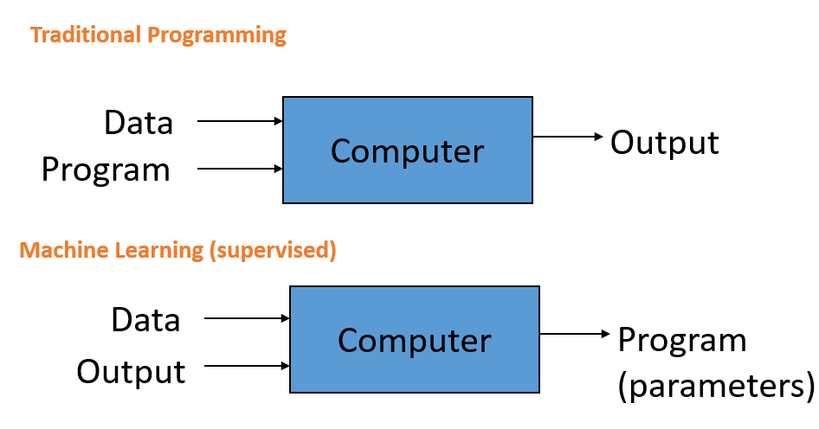
Machine Learning definition
Arthur Samuel (1959). Machine Learning: Field of study that gives computers the ability to learn without being explicitly programmed.

Slide 3
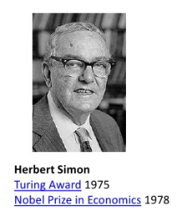
Machine Learning definition
Herbert Simon.
Learning is any process by which a system improves performance from experience.
Machine Learning is concerned with computer
programs that automatically improve their
performance through experience.

Slide 4
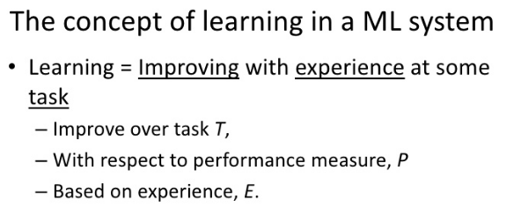
Machine Learning definition
Tom Mitchell (1998). A computer program is said to learn from experience E with respect to some task T and some performance measure P, if its performance on T, as measured by P, improves with experience E.

Slide 5
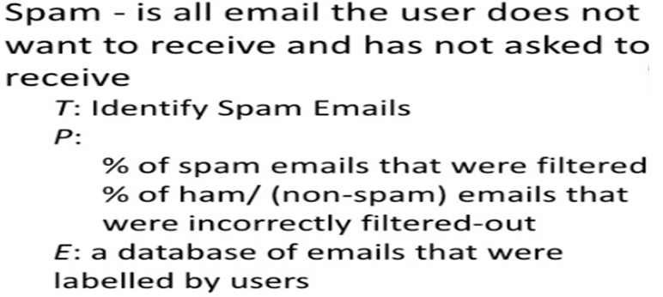
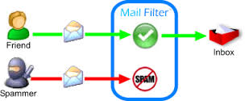
Example: Spam Filtering

Slide 6
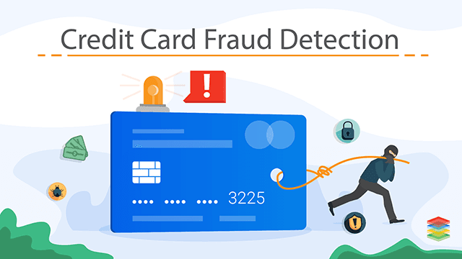
Question 1.1. Learning to detect credit card fraud. What are T, P and E?

Slide 7
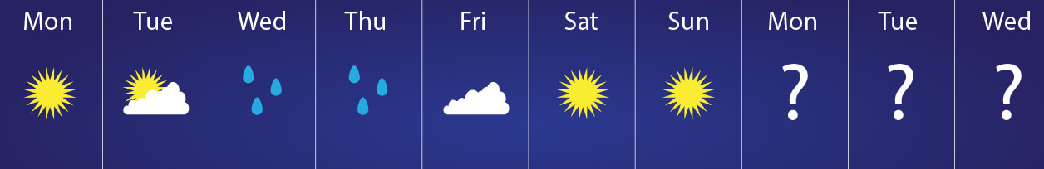
Question 1.2.
Suppose we feed a learning algorithm a lot of historical weather data, and have it learn to predict weather. What are E, P and T?

Slide 8
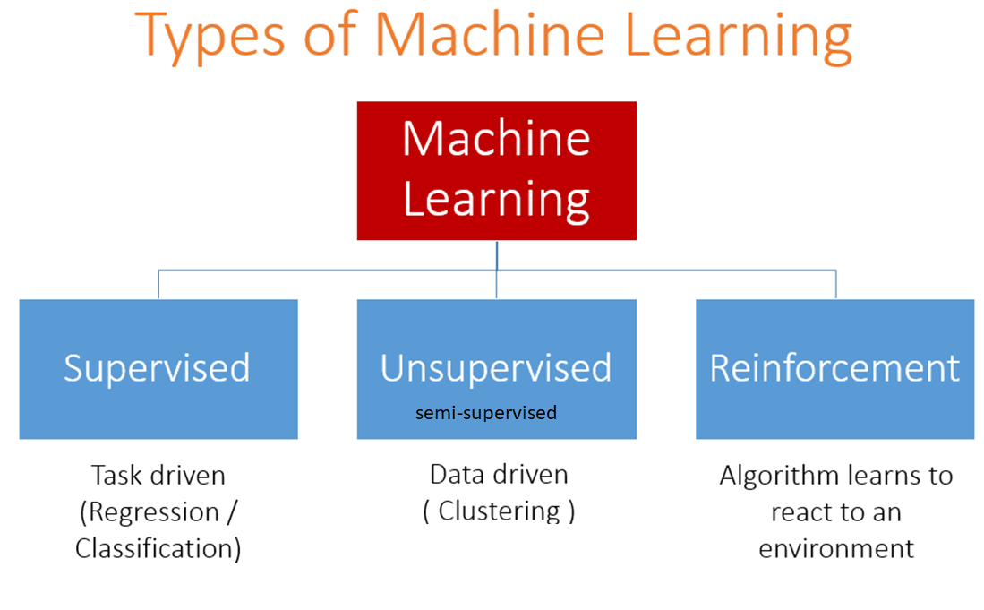

Slide 9
Key ML Terminology
Labels
A label is the thing we're predicting.
Features
A feature is an input variable
Examples or samples
An example is a particular instance of data, x.
labeled examples. A labeled example includes both feature(s) and the label.
unlabeled examples. An unlabeled example contains features but not the label.
Models
A model defines the relationship between features and label.
Training means creating or learning the model.
Inference means applying the trained model to unlabeled examples.

Slide 10
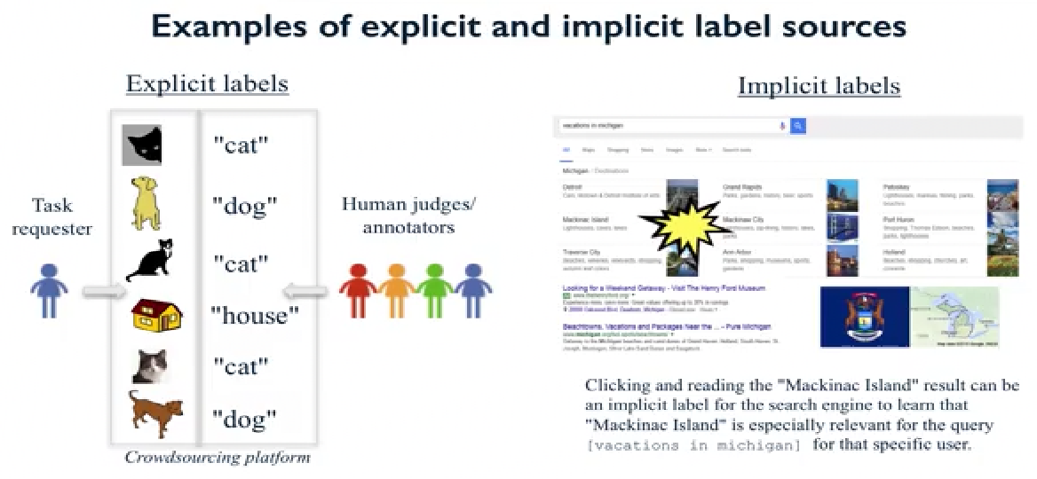

Slide 11
Key types of Machine Learning problems
Supervised machine learning: Learn to predict target values from labelled data/
Classification (target values are discrete classes)
Regression (target values are continuous values)
Unsupervised machine learining: Find structure in unlabeled data
Find groups of similar instances in the data (clusterin)
Finding unusual patterns (outlier detection)

Slide 12
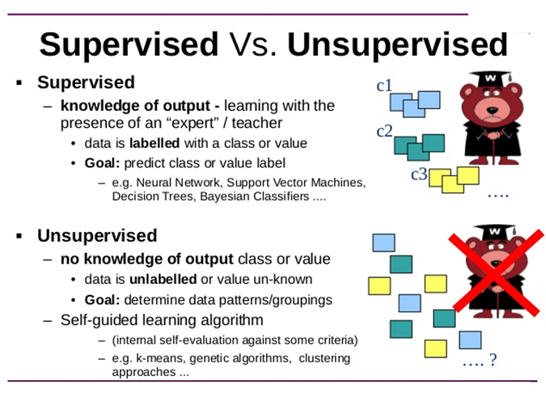

Slide 13


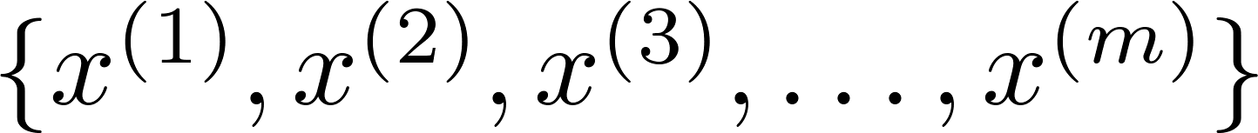
Supervised learning Unsupervised learning
Training set: Training set:

Slide 14
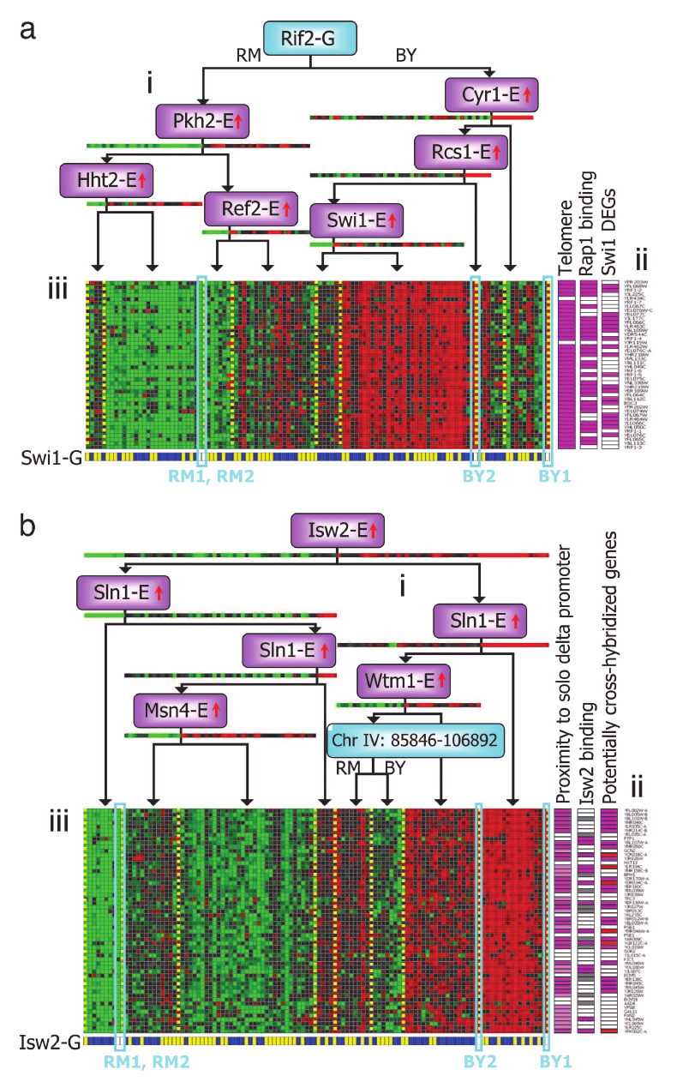
Genes
Individuals
[Source: Su-In Lee, Dana Pe’er, Aimee Dudley, George Church, Daphne Koller]

Slide 15



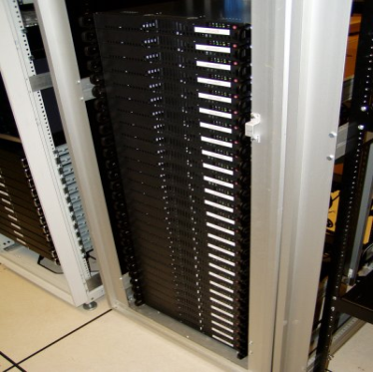
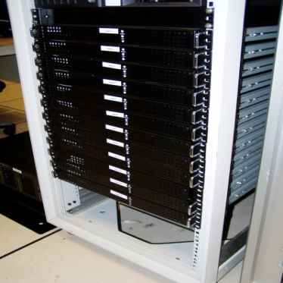
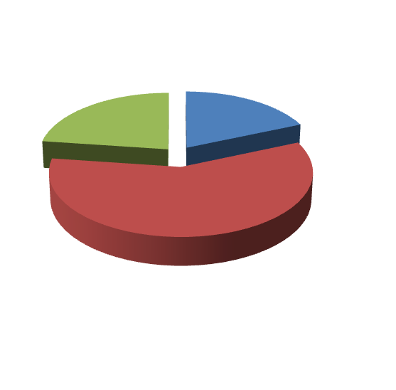
Applications of clustering
Market segmentation
Social network analysis
Image credit: NASA/JPL-Caltech/E. Churchwell (Univ. of Wisconsin, Madison)
Organize computing clusters
Astronomical data analysis
Notes:
Swap: market seg and organize clusters

Slide 16
1.3. Supervised or Unsupervised?
Examine the statistics of two football teams, and predicting which team will win tomorrow's match (given historical data of teams' wins/losses to learn from).

Slide 17
1.4.Supervised or Unsupervised?
In farming, given data on crop yields over the last 50 years, learn to predict next year's crop yields.

Slide 18
1.5.Supervised or Unsupervised?
Take a collection of 1000 essays written on the Azerbaijan Economy, and find a way to automatically group these essays into a small number of groups of essays that are somehow "similar" or "related".

Slide 19
1.6. Supervised or Unsupervised?
Given data on how 1000 medical patients respond to an experimental drug (such as effectiveness of the treatment, side effects, etc.), discover whether there are different categories or "types" of patients in terms of how they respond to the drug, and if so what these categories are.

Slide 20
1.7. Supervised or Unsupervised?
Given 50 articles written by male authors, and 50 articles written by female authors, learn to predict the gender of a new manuscript's author (when the identity of this author is unknown).

Slide 21
1.8. Supervised or Unsupervised?
Given a large dataset of medical records from patients suffering from heart disease, try to learn whether there might be different clusters of such patients for which we might tailor separate treatments.

Slide 22
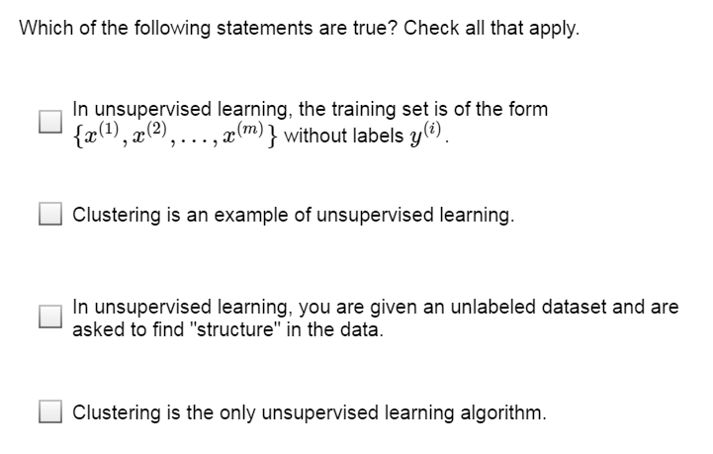
Question 1.9

Slide 23
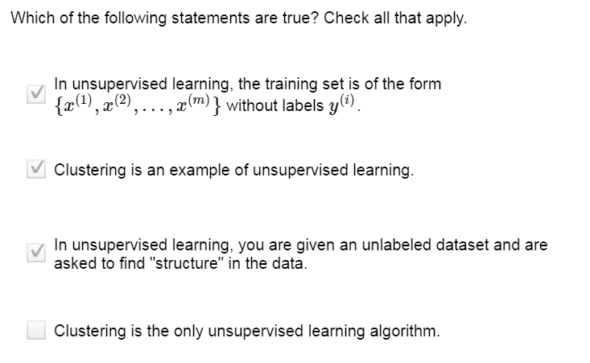

Slide 24
Key types of Machine Learning problems
Supervised machine learning: Learn to predict target values from labelled data/
Classification (target values are discrete classes)
Regression (target values are continuous values)
Unsupervised machine learining: Find structure in unlabeled data
Find groups of similar instances in the data (clusterin)
Finding unusual patterns (outlier detection)

Slide 25
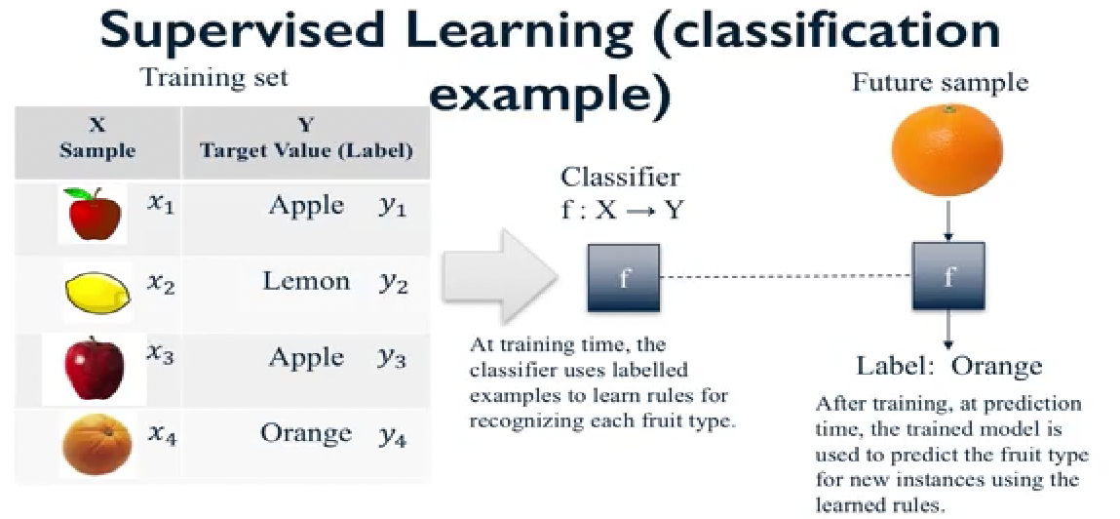

Slide 27
1.10. Classification or Regression?
The amount of rain that falls in a day is usually measured in either millimeters (mm) or inches. Suppose you use a learning algorithm to predict how much rain will fall tomorrow. Would you treat this as a classification or a regression problem?

Slide 28
1.11. Classification or Regression?
Suppose you are working on stock market prediction, Typically tens of millions of shares of Microsoft stock are traded (i.e., bought/sold) each day. You would like to predict the number of Microsoft shares that will be traded tomorrow. Would you treat this as a classification or a regression problem?

Slide 29
1.12. Classification or Regression?
Suppose you are working on weather prediction, and your weather station makes one of three predictions for each day's weather: Sunny, Cloudy or Rainy. You'd like to use a learning algorithm to predict tomorrow's weather. Would you treat this as a classification or a regression problem?

